Slide 1
Responsible ai

Slide 2

AI RISKS AND CHALLENGES
Opportunity to unlock trapped value
Unintended consequences
Compliance
challenge
Notes:
AI affords a tremendous opportunity not only to increase efficiencies and reduce costs, but has the capacity to help rethink businesses and solve critical problems.
AI affords a tremendous opportunity not only to increase efficiencies and reduce costs, but has the capacity to help rethink businesses and solve critical problems.
Deploying AI without anchoring to robust compliance and core values may expose a business to significant risks including employment/HR, data privacy, health and safety issues. The potential fines and sanctions can be business threatening.

Slide 3
The next few years are critical for AI investment…
R&D Budgets of AI-intensive firms and select countries, 2015
USA
$587.7B
China
$478.6B
Korea
$93.6B
UK
$53.5B
Russia
$47.6B
Spain
$22.9B
Mexico
$14B
Amazon
$12.5B
Google
$12.3B
Microsoft
$12B
Denmark
$9.5B
Apple
$8.1B
Norway
$7.4B
IBM
$5.2B
Facebook
$4.8B
Chile
$1.8B
Baidu
$1.67B
Alibaba
$1.6B
Iceland
$389M
Countries
Firms

Slide 4

WHAT ARE COMMON CONCERNS ABOUT AI?

Slide 5

COMMON ETHICAL ISSUES RAISED BY AI
JOB APOCALYPSE
INCLUSION & DIVERSITY
THE SINGULARITY
ARTIFICIAL STUPIDITY
ETHICAL
ISSUES
LACK OF TRANSPARENCY
PRIVACY
Notes:
INCLUSION & DIVERSITY The power of AI is in the hands of the few and with the traditional power brokers.
ARTIFICIAL STUPIDITY
AI is actually pretty stupid right now, and can lead to an embarrassing PR incident or worse, do something discriminatory.
PRIVACY
AI will erode our notions of data privacy and do things with data that we didn’t consent to.
LACK OF TRANSPARENCY True (scary) AI doesn’t explain itself.
THE SINGULARITY We will create something that is more intelligent than humans and we will lose control.
Job Apocalypse: AI is so ruthlessly efficient that it will lead to massive job loss.

Slide 6
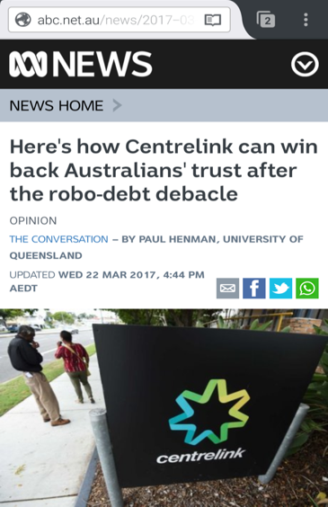
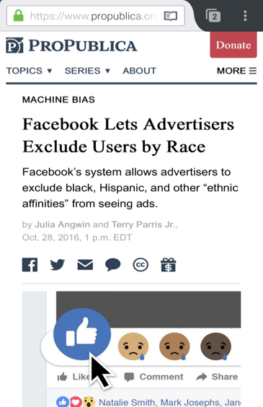
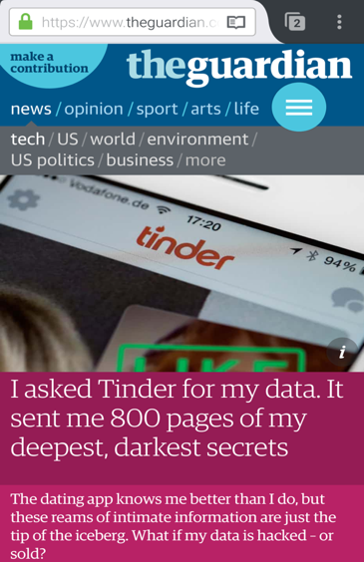
Erosion of trust
IMMEDIATE
IMPACTFUL
INVISIBLE
Notes:
Australia’s Centrelink algorithm before Christmas sent out “debt recovery” notices that impacted welfare recipients disproportionately and was found to be flawed in its calculations. Government was accused of engaging in the equivalent of spamming, by sending out thousands of obviously wrong assessments in the hope of getting money while they are contested. http://www.theage.com.au/comment/centrelinks-robodebacle-is-a-litany-of-inhuman-errors-20170103-gtl77k.html
Facebook allowed their advertisers to exclude users by race in housing ads. https://www.propublica.org/article/facebook-lets-advertisers-exclude-users-by-race – Facebook allows its advertisers to target audiences by the use of “ethnic affinity marketing”. When applied to housing, employment or credit, this is illegal under US law. An investigation by a news organization exposed that landlords were excluding minorities from housing ads and that Facebook was approving the ads. Following this investigation, (1) a representative from the Department of Housing and Urban Development, which enforces anti-discrimination laws, said that it was investigating Facebook and (2) a class action lawsuit was also filed against Facebook, alleging violations of the Fair Housing Act and the Civil Rights Act of 1964. Facebook dismantled the program within 2.5 weeks of the news story.
https://www.theguardian.com/technology/2017/sep/26/tinder-personal-data-dating-app-messages-hacked-sold
Harvard study that when you enter African-American sounding names, ads for arrest records are provided: https://www.technologyreview.com/s/510646/racism-is-poisoning-online-ad-delivery-says-harvard-professor/
Our laws and regulations codify our norms and values around what we think both promotes ethical behavior and penalizes bad behavior. Ultimately governments are concerned about whether technologies are creating unfair, unethical or discriminatory effects on their consumers.
All companies should think carefully about where “value-added personalization and segmentation” ends, and harmful discrimination begins.
FCRA does not apply to companies when they use data derived from their own relationship with their customers for purposes of making decisions about them. But if an unaffiliated firm regularly evaluates companies’ own data and provides the evaluations to the companies for eligibility determinations, the unaffiliated firm would likely be acting as a CRA, each company would likely be a user of consumer reports and all of these entities would be subject to FTC enforcement under the FCRA.

Slide 7



What are clients asking?
OPERATIONS
HUMAN AGENCY
FUTURE OF WORK
How do I guard against data breaches and hacking?
What architecture or internal frameworks do I have to build to be in compliance with GDPR and other regulations?
How can I institute ethical design practices at all levels of the AI project lifecycle?
How do I maintain and monitor my AI solutions to understand how my AI evolves over time?
How do I create a personalized consumer experience without violating a customer’s sense of privacy?
How do I create AI solutions that enable good decision-making by my employees and keep the human in the loop?
How can I be transparent about my AI solutions to build trust?
How do I address a situation where a significant number of my employees lose their jobs due to automation?
How do I transition my employees to an AI workforce?
What are the skills needed for the future of work? How can I identify them?
How does leadership need to change or evolve in the AI economy?

Slide 8

responsible operations

Slide 9




Responsible project design and deployment
TEAM EFFORT
DATA INVESTIGATION
CREATING A CULTURE OF RESPONSIBILITY
MAINTENANCE AND MONITORING
Designing AI solutions to be ‘understandable’ by non-technical users
Identifying roles and responsibilities for data and model investigation
Enabling leadership to make critical decisions on the questions that arise
Standardized procedures for data exploration
Critical thinking framework for exploring the unknown
Edge case testing
Assigning a chain of command to escalate and address concerns
Prioritizing Responsible AI efforts in project workflows
Testing models to ensure they are still accurate post-launch
Exploring new methods as AI capabilities evolve
Agile maintenance

Slide 10

‘EXPLAINABLE’ AI
Unpacking ‘black box’ algorithms
Logical entailment: factual explanations of decision-making based on algorithmic outcomes
Deployed as an algorithm to supplement AI
‘UNDERSTANDABLE’ AI
Creating UI/UX to enable the end user to make informed decisions
Designing a user experience to explain AI model output for non-black box models
Part of the product design and development process.

Slide 11

FUTURE of WORK

Slide 12






trends reshaping work
NEW sources of Workforce
THE AUTOMATION EFFECT
From Jobs To TASKS
PACE OF
INNOVATION
Reshoring
Notes:
From jobs to tasks:
Shift towards project / task-based work
Emphasis on collaboration, agility and skill sharing
NEW SOURCES OF WORKFORCE
Increased expansion of workforce including freelancers and crowd platforms
Flash teams
Boundary-less, flexible teams with expanded labor pools
THE AUTOMATION EFFECT
Automating routinized jobs, taking on menial tasks
Reducing error and optimizing operations
Freeing up workers for higher-value tasks
PACE OF INNOVATION
Emerging new technologies driving digital transformation
Human-machine collaboration
RESHORING
After years of outsourcing, jobs are “reshoring” due to affordability of robots
# of reshored jobs not equivalent to jobs that were outsourced
Reshored jobs tend to be higher skilled jobs involving supervision of robots and use of “digital twins”

Slide 13
where enterprises expect to be in five years (ACCENTURE RESEARCH STUDY)
Human-Centric
Machine-Centric
Where companies are today
27%
35%
24%
11%
3%
5 years from now
4%
11%
29%
30%
26%
Notes:
For every robot brought into the U.S. workforce between 1990 and 2007, six human jobs were lost, the National Bureau of Economic Research found in a study released earlier this year.
According to the Committee for the Economic Development of Australia, 40% of jobs in Australia (about 5M of them) are likely to be automated in the next 10 to 15 years. OECD indicates that the % is probably closer to 9%.

Slide 14
And recasting the skilled needed in 2020
TODAY
1. Complex problem solving
2. Coordinating with others
3. People Management
4. Critical Thinking
5. Negotiation
6. Quality Control
7. Service Orientation
8. Judgment and Decision Making
9. Active Learning
10. Creativity
2020
1. Complex problem solving
2. Critical Thinking
3. Creativity
4. People Management
5. Coordinating with others
6. Emotional Intelligence
7. Judgment and Decision Making
8. Service Orientation
9. Negotiation
10. Cognitive Flexibility
Source: Future of Jobs Report, World Economic Forum

Slide 15




TALENT Strategy Implications
TALENT
Defining new digital and analytic competencies
Upskilling and continuous learning
CULTURE
Collaborative, agile, innovative mindsets
Change-ready organizations
Leadership
Cross-functional and agile leadership
Empowering future leaders
OPERATING MODEL
Robotics COE
Human-robot hybrid organization
Notes:
Talent:
Reorganize resources in the retained human workforce, and locate new talent (build, buy, or rent talent pool) to complement RPA’s virtual workforce
Define the new roles are needed to oversee, manage, protect, and infuse ethics into RPA and AI solutions
Develop a learning strategy as employees take on more rewarding activities that require higher complexity and judgement
Define talent strategy focused on acquiring talent with competencies in digital, knowledge of automation, process excellence, data analysis, and expertise in soft skills
Use a digital transformation as a catalyst to reimagine the employee experience
Leadership
Support leaders in actively participating as a member of a cross-functional agile team to design, develop, and deploy RPA and digital solutions in the organization
Enable leaders with the tools to lead their workforces in a dynamic, ambiguous, agile, and digital world
Define new ways of leading that relinquish control and empower employees to make decisions in new roles
Develop a digital leadership strategy that will upskill leaders with the skills and capabilities needed to drive innovation throughout their organizations
Culture
Identify mindsets and behaviors to articulate how the organization will achieve its vision and to create a common language for how people need to act
Define mindsets to support shift to automation (e.g., collaborative, agile, empowered, innovative, automation familiarity, customer-centric) and the behaviors that exemplify those mindsets in the context of the change and organization
Emphasize continuous learning to build an adaptable, change-ready organization
Recognize, reward, and celebrate desired behaviors and lessons learned
Embed change culture in RPA teams to enhance the automation benefits captured. This includes an iterative build of impacts, an emphasis on post-go live behavioral change, a strong focus on change network and real-time coaching
Operating Model
Consider establishing a centrally managed robotics CoE organization that can drive digitization and robotics at the required scale and pace
Understand the organizational design requirements to enable both human-robot collaboration and seamless collaboration across the organization
Define the right processes, functions and interaction models to support automation across the organization

Slide 16



With RAPID ADOPTION OF ROBOTS across Asia - ANZ
1.9M robots in operation across asia – Anz by 2020 This is equivalent to the number of robots globally in 2016
South korea has the highest robot density in the world – 63 per 1,000 employees The us has about 30 per 1,000 employees
89% of all robots sold went to china, south korea and japan China (43%), S korea (24%), japan (22%)
Notes:
In the first quarter of 2017, North American companies bought 32 percent more robots than the same period last year, according to data from the Robotic Industries Association.
Asian industry’s uptake of industrial robots is accelerating: in just five years its operational stock rose 70 percent to 887,400 units, (2010-2015) according to the International Federation of Robots. China is the biggest market for industrial robots in the world and takes 43 percent of all sales to Asia including Australia and New Zealand. It is followed by the Republic of Korea, with a share of 24 percent of regional sales, and Japan with 22 percent. That means 89 percent of robots sold in Asia and Australia went to these three countries in 2015. South Korea has the highest level of robot density in the world, about 630 robots installed per 10,000 employees in the manufacturing industry in 2016. Korea is a market leader in LCD and memory chip manufacturing.
These machines are defined by The International Federation of Robotics as “an automatically controlled, reprogrammable, and multipurpose [machine]” (IFR 2014; see also Graetz and Michaels, 2015). Industrial robots are fully autonomous machines that can be programmed to perform several manual tasks such as welding, painting, assembling, handling materials, or packaging. This definition excludes other types of capital, such as software, that may also replace labour, and machines designed for a single function, such as cranes, circuit printers, textile looms or coffee machines.

Slide 17






What is Accenture doing to address governance?
AI INSIDE
STANDARDS
INDUSTRY ORGS
ENGAGING WITH:
AI INSIDE
Academia
Public policy
Non-profits
Notes:
Inside:
Governance lifecycle: Inventory, assessing, monitoring, auditing
Fundamentals: Updating a Code of Business Ethics, to include AI, data, etc
Central governance committee: multidisciplinary, aim to coach not to police
Chief Compliance Officer / Ethics officer
Internal research units (deepmind)

Slide 18

HOW CAN WE HELP YOU ON YOUR
RESPONSIBLE AI JOURNEY?

Slide 19

ATHINA TO DELETE – PAGES COULD GIVE BROADER CONTEXT
APPENDIX

Slide 20
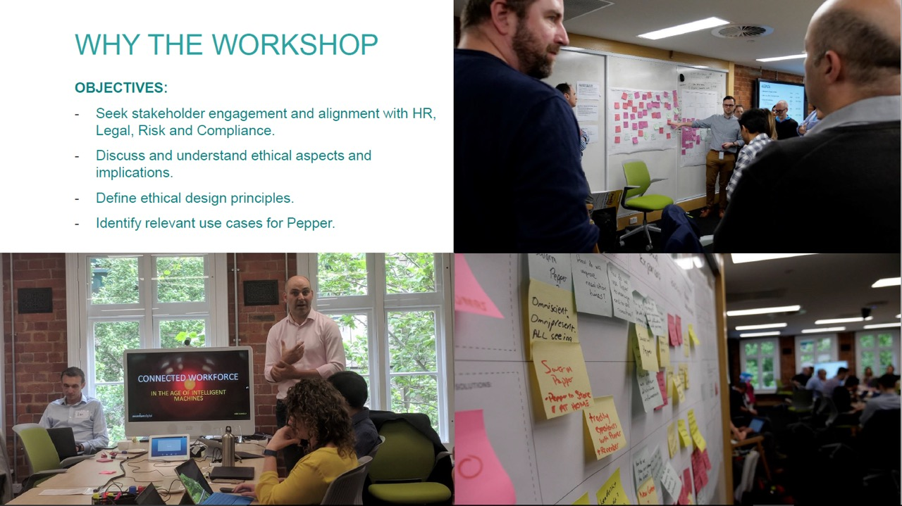
Why the workshop
OBJECTIVES
Seek stakeholder engagement and alignment with HR, Legal, Risk and Compliance. Discuss and understand ethical aspects and implications. Define ethical design principles.
Identify relevant use cases for Pepper.

Slide 21
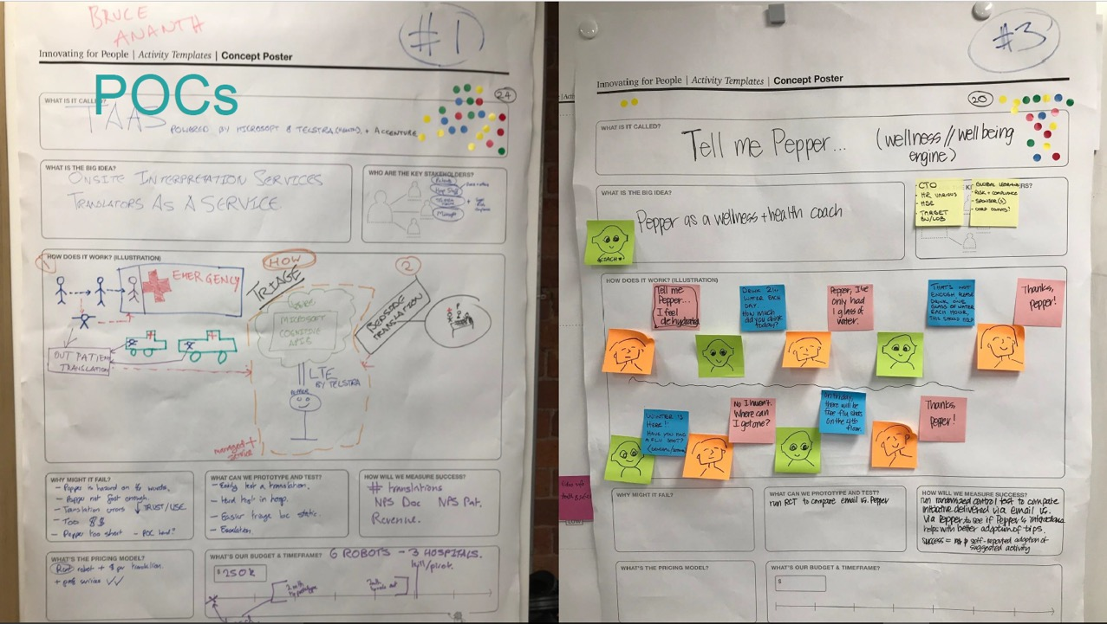

Slide 22
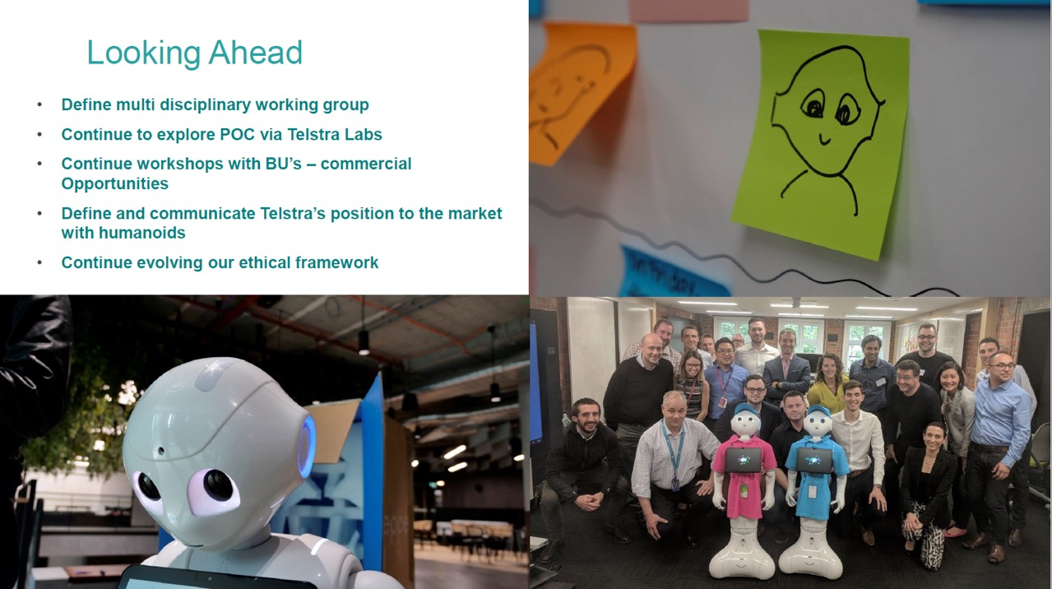
Looking ahead
Define multi-disciplinary working group Continue to explore POC via Telstra Labs Continue workshops with BU’s – commercial opportunities Define and communicate Telstra’s position to the market with humanoids Continue evolving our ethical framework

Slide 23

The case for governance: Oxford - Wikipedia bot study
Notes:
http://journals.plos.org/plosone/article?id=10.1371/journal.pone.0171774
Need for bots grew as Wikipedia’s content grew (40M pages across 293 languages)
Examined bots that provided editing functionality. These bots add links to other Wikipedia pages, undo vandalism, flag copyright violations, check spelling, and carry out a host of other tasks that can be automated. This frees up the human editors to add information and make editorial changes that depend on more than basic grammar rules.
Bots were in a silent war with each other, for years. Whatever the disagreement, every time one of them changes something on a Wikipedia page, the other will inevitably come along and revert it back. And they'll keep doing that ad infinitum, because they're bots and they'll never get tired of it. Humans will eventually notice that they're undoing the same mistake over and over and try to find a workaround. Bots won't stop unless the humans who created them notice what's going on.
On a site like Wikipedia, though, you might never notice. There's no top-down structure to the bots—they have to follow certain guidelines, but anyone can submit a bot—and once approved, it goes out and edits 40 million articles on its own. If it's in opposition to some other bot out there, it's up to the two creators to work it out. No one's around to police you.
Bots are predictable automatons that do not have the capacity for emotions, meaning-making, creativity, and sociality and it is hence natural to expect interactions between bots to be relatively predictable and uneventful. In this article, we analyze the interactions between bots that edit articles on Wikipedia. We track the extent to which bots undid each other’s edits over the period 2001–2010, model how pairs of bots interact over time, and identify different types of interaction trajectories. We find that, although Wikipedia bots are intended to support the encyclopedia, they often undo each other’s edits and these sterile “fights” may sometimes continue for years. Unlike humans on Wikipedia, bots’ interactions tend to occur over longer periods of time and to be more reciprocated. Yet, just like humans, bots in different cultural environments may behave differently. Our research suggests that even relatively “dumb” bots may give rise to complex interactions, and this carries important implications for Artificial Intelligence research. Understanding what affects bot-bot interactions is crucial for managing social media well, providing adequate cyber-security, and designing well functioning autonomous vehicles.
The disagreements likely arise from the bottom-up organization of the community, whereby human editors individually create and run bots, without a formal mechanism for coordination with other bot owners. Delving deeper into the data, we found that most of the disagreement occurs between bots that specialize in creating and modifying links between different language editions of the encyclopedia. The lack of coordination may be due to different language editions having slightly different naming rules and conventions.
ur data cover a period of the evolution of Wikipedia when bot activity was growing. Evidence suggests that this period suddenly ended in 2013 (http://stats.wikimedia.org/EN/PlotsPngEditHistoryTop.htm). This decline occurred because at the beginning of 2013 many language editions of Wikipedia started to provide inter-language links via Wikidata, which is a collaboratively edited knowledge base intended to support Wikipedia. Since our results were largely dictated by inter-language bots, we believe that the conflict we observed on Wikipedia no longer occurs today. One interesting direction for future research is to investigate whether the conflict continues to persist among the inter-language bots that migrated to Wikidata.
The Wikipedia bot ecosystem is gated and monitored and this is clearly not the case for systems of malevolent social bots, such as social bots on Twitter posing as humans to spread political propaganda or influence public discourse. Unlike the benevolent but conflicting bots of Wikipedia, many malevolent bots are collaborative, often coordinating their behavior as part of botnets [27]. However, before being able to study the social interactions of these bots, we first need to learn to identify them [28].
In the case of Wikipedia, we see that benevolent bots that are designed to collaborate may end up in continuous disagreement. This is both inefficient as a waste of resources, and inefficacious, for it may lead to local impasse. Although such disagreements represent a small proportion of the bots’ editorial activity, they nevertheless bring attention to the complexity of designing artificially intelligent agents. Part of the complexity stems from the common field of interaction—bots on the Internet, and in the world at large, do not act in isolation, and interaction is inevitable, whether designed for or not. Part of the complexity stems from the fact that there is a human designer behind every bot, as well as behind the environment in which bots operate, and that human artifacts embody human culture. As bots continue to proliferate and become more sophisticated, social scientist will need to devote more attention to understanding their culture and social life.

Slide 24
TEN COMMANDMENTS OF AI Microsoft’s proposed Commandments for AI
TECHNOLOGY
A.I. must be designed to assist humanity.
A.I. must be transparent.
A.I. must maximize efficiencies without destroying the dignity of people.
A.I. must be designed for intelligent privacy — in ways that earn trust.
A.I. must have algorithmic accountability so that humans can undo unintended harm.
A.I. must guard against bias.
HUMAN
Start with EMPATHY
Invest in Education
Go forth creatively
Reserve the right of judgment and maintain accountability.

Slide 25
Yves behar’s principles for design in the age of ai
Design solves an important human problem.
Design is context specific (it doesn’t follow historical clichés)
Design enhances human ability (without replacing the human)
Good design works for everyone, everyday
Good tech & design is discreet
Good design is a platform that grows with needs and opportunities
Good design brings about products & services that build long-term relationships (but don’t create emotional dependency)
Good tech design learns and predicts human behavior
Good design accelerates new ideas
Good design removes complexity from life

Slide 26
ABOUT ACCENTURE
Accenture is a leading global professional services company, providing a broad range of services and solutions in strategy, consulting, digital, technology and operations. Combining unmatched experience and specialized skills across more than 40 industries and all business functions—underpinned by the world’s largest delivery network—Accenture works at the intersection of business and technology to help clients improve their performance and create sustainable value for their stakeholders. With more than 435,000 people serving clients in more than 120 countries, Accenture drives innovation to improve the way the world works and lives. Visit us at www.accenture.com.
This document makes descriptive reference to trademarks that may be owned by others. The use of such trademarks herein is not an assertion of ownership of such trademarks by Accenture and is not intended to represent or imply the existence of an association between Accenture and the lawful owners of such trademarks.
Copyright © 2018, Accenture. All rights reserved. Accenture, its logo, and High Performance Delivered are trademarks of Accenture.
Accenture interprets the following words and phrases used herein in the manner indicated: “maximize”, “optimize”, “optimal” means to improve to a commercially reasonable degree; “minimize” means to reduce to a commercially reasonable degree; “best” means leading or of a high standard; “partner”, “partnerships” does not mean a legal partnership, but rather a collaborative relationship; “right” where used as an adjective means appropriate; and “ensure” and “enable” means to use commercially reasonable efforts to implement
Copyright © 2018 Accenture. All rights reserved.
26

